Slide 1
Energy Transition
Dry Bulk
The 10th City of London Biennial Meeting

Slide 2
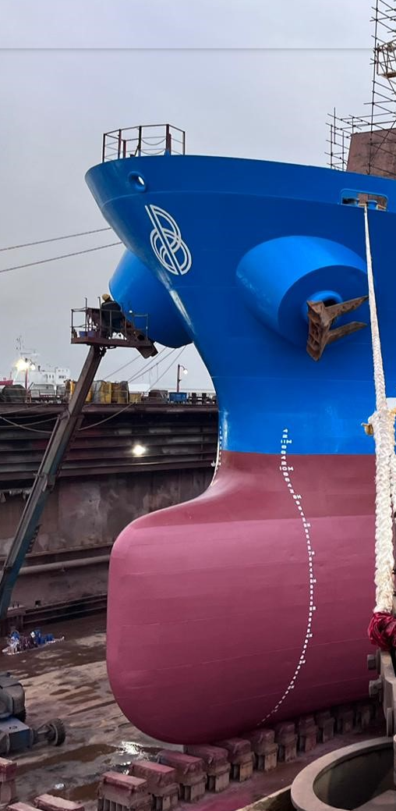
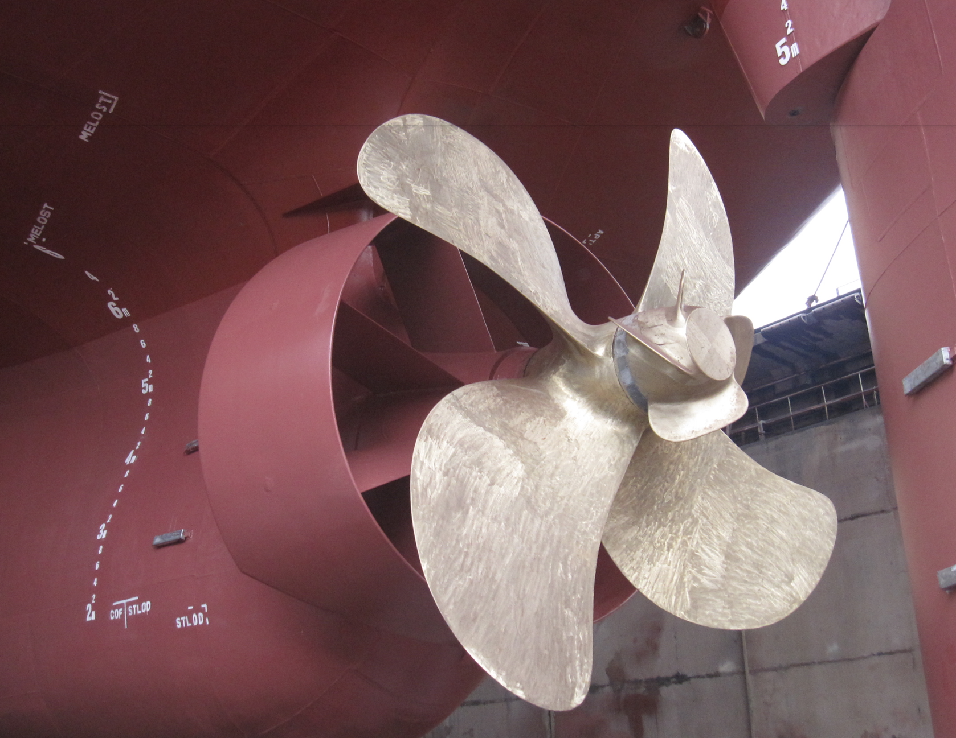
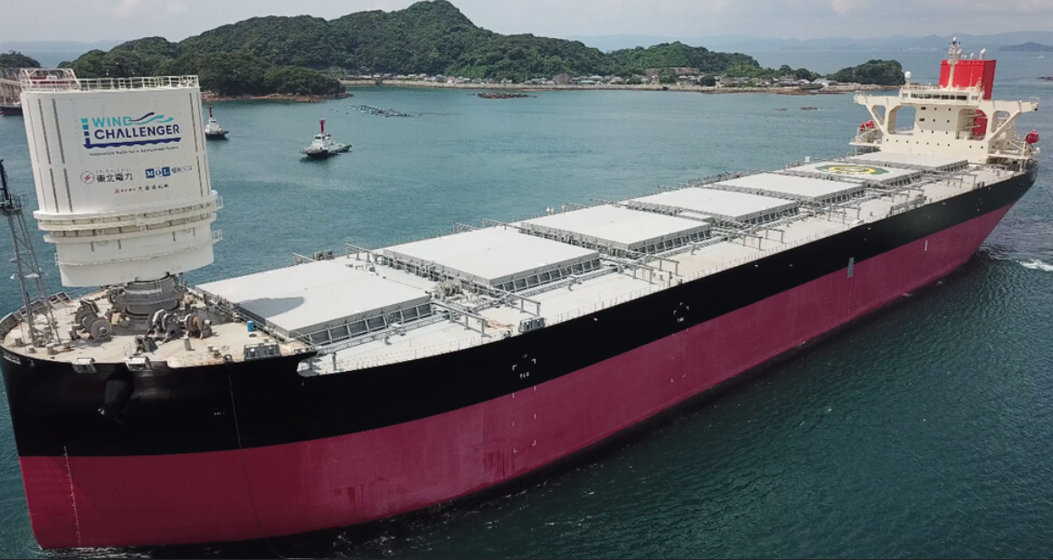
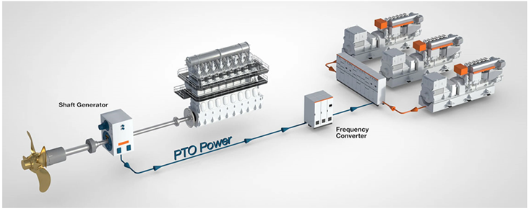
Energy Saving Devices (ESDs)
Low friction paints
Propeller (Mewis) Duct; PBCF
Rudder Fin; Rudder Bulb; Pre-swirl (stator) fin
Bow Enhancement
Shaft generator
Wind
Air lubrication
Solar power

Slide 3
Virtual Arrival / “just in time”

Slide 4
Alternative Propulsions

Slide 5
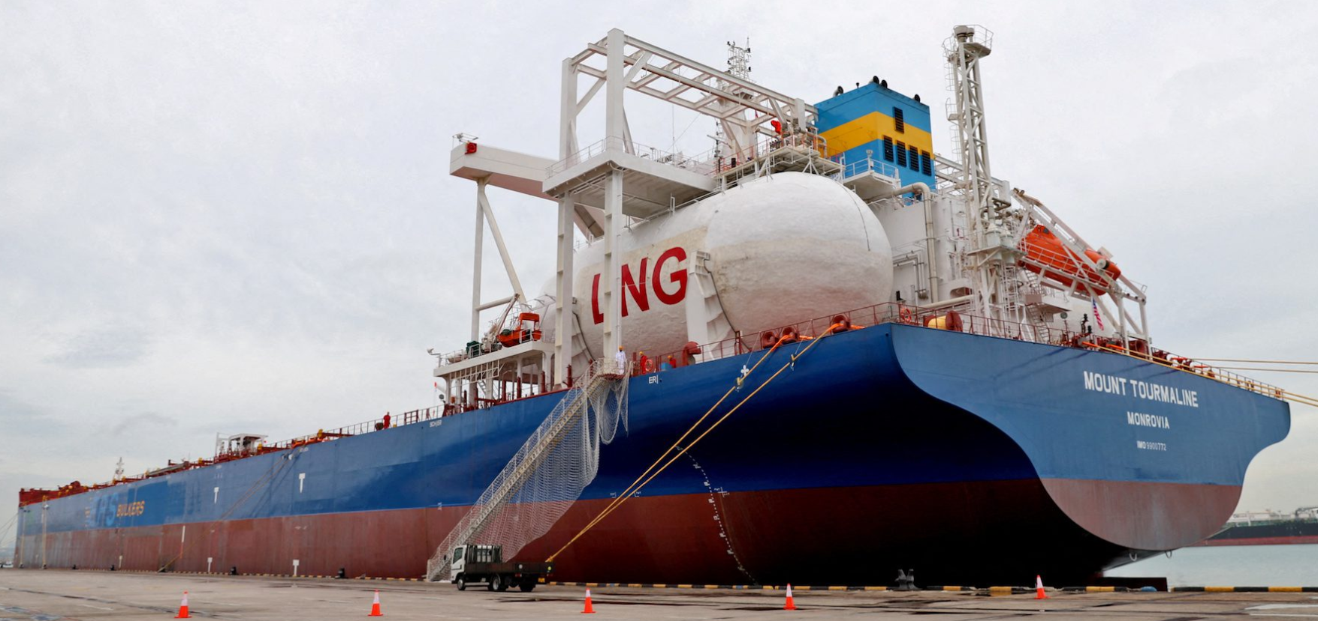
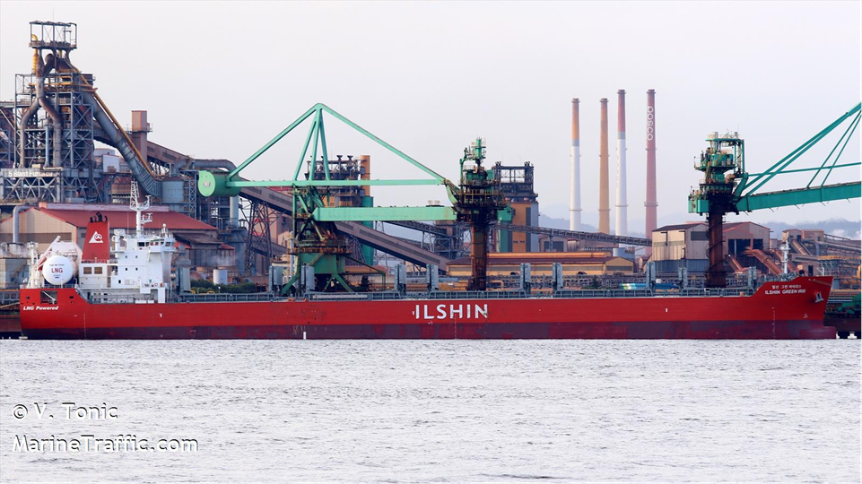
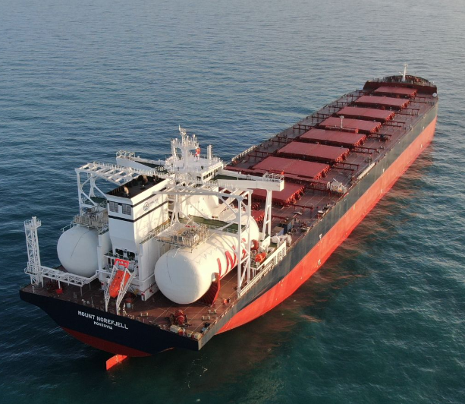
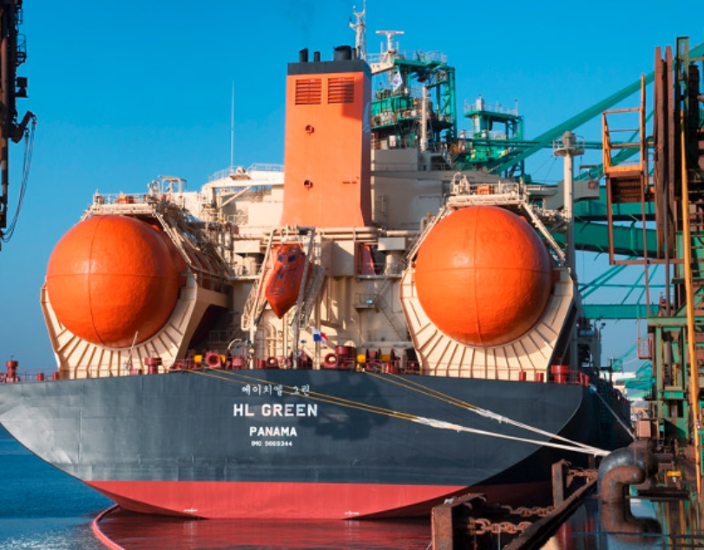
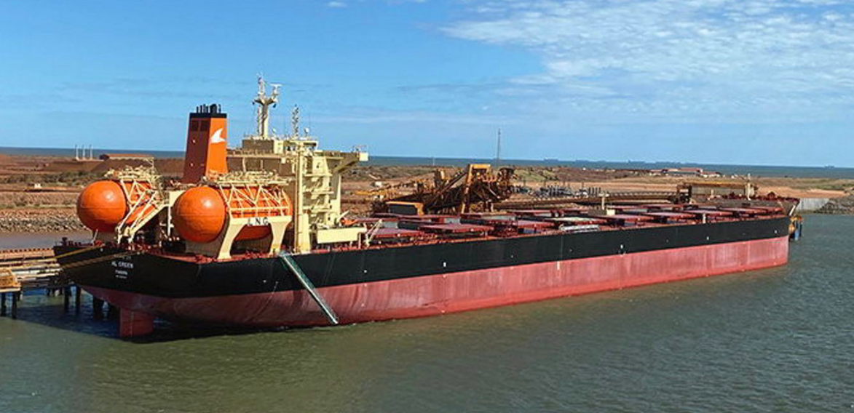
LNG-DF

Slide 6
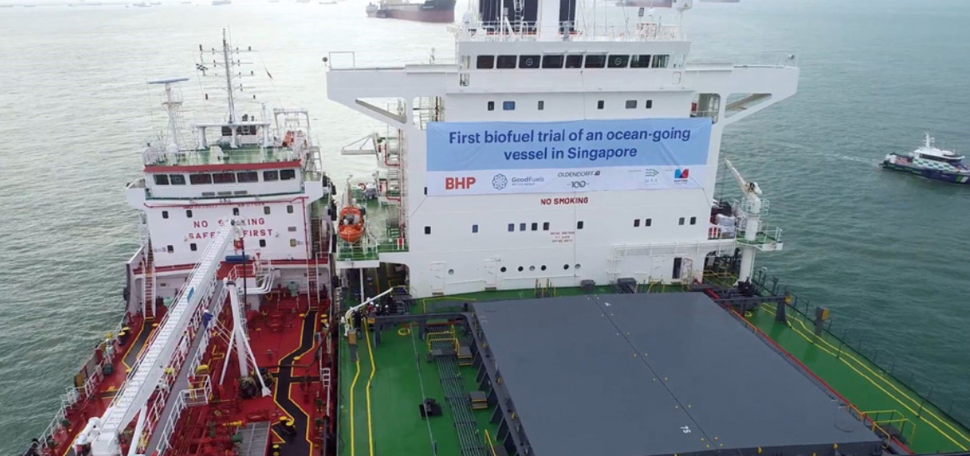

Bio/”E” fuels (oil/gas)

Slide 7
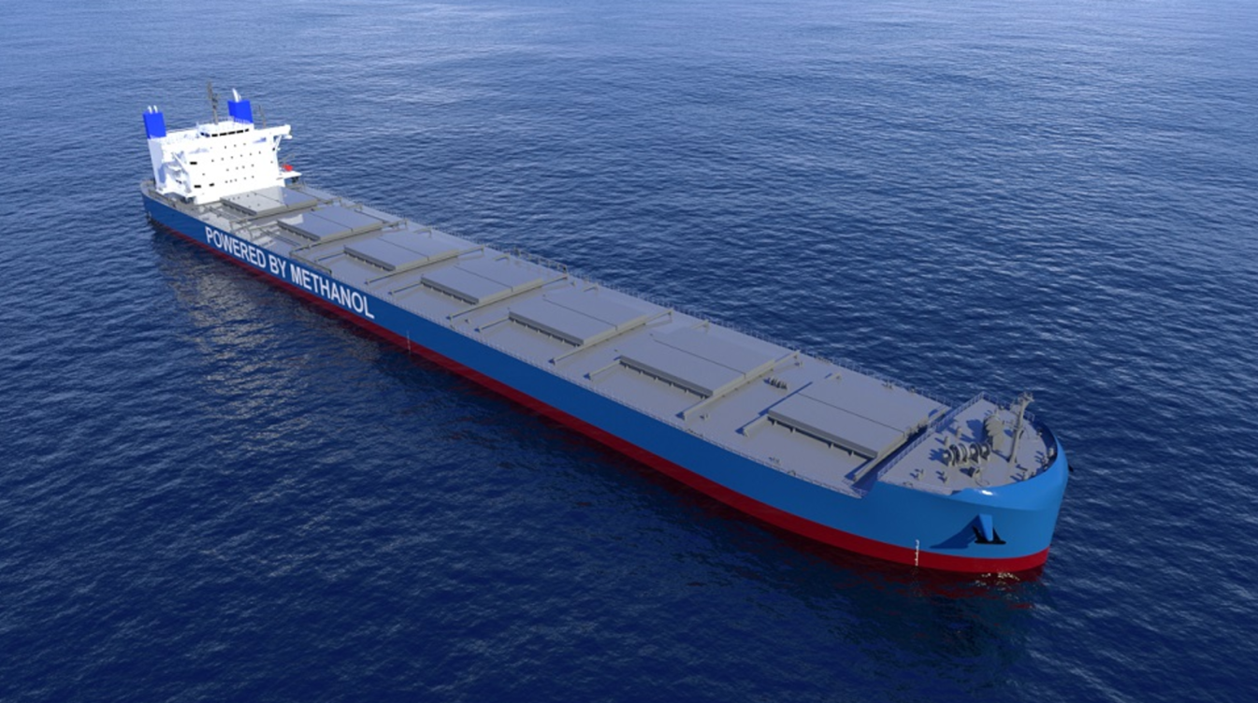
Methanol-DF

Slide 8
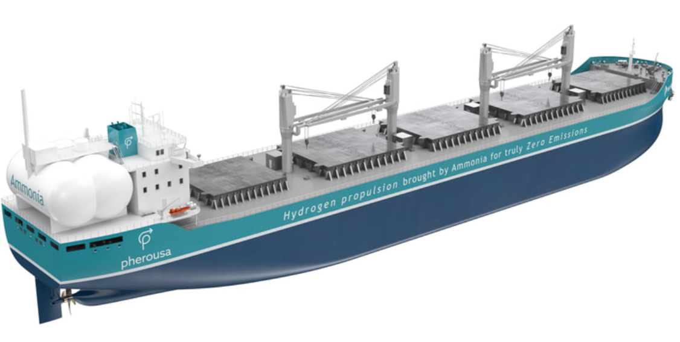
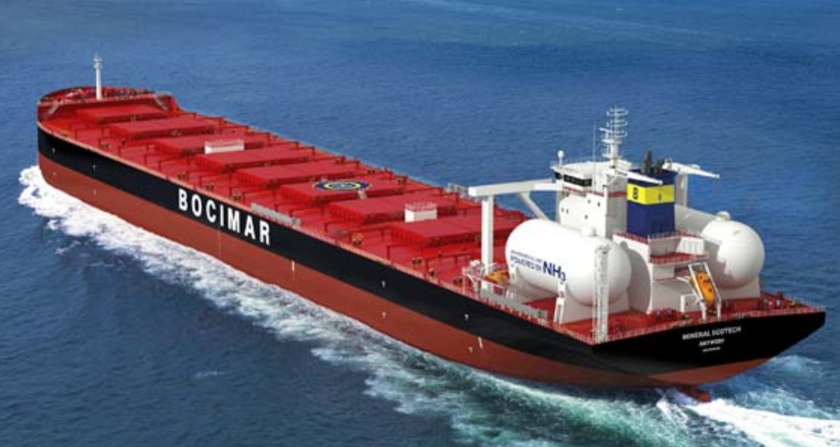
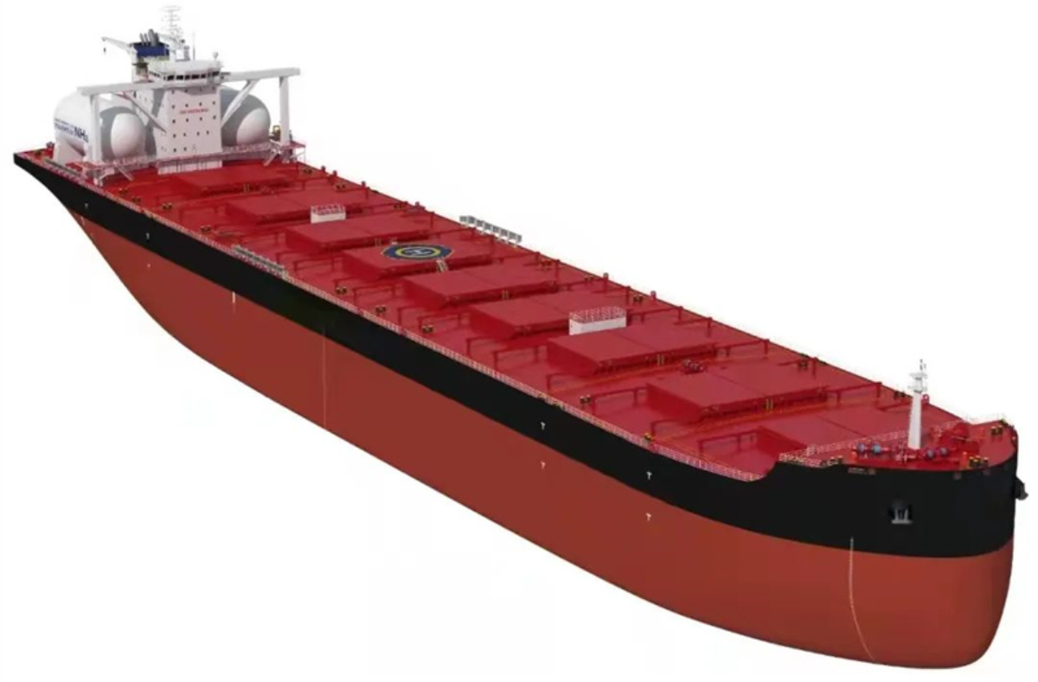
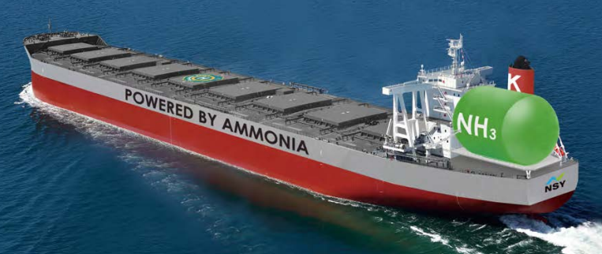
Ammonia-DF

Slide 9
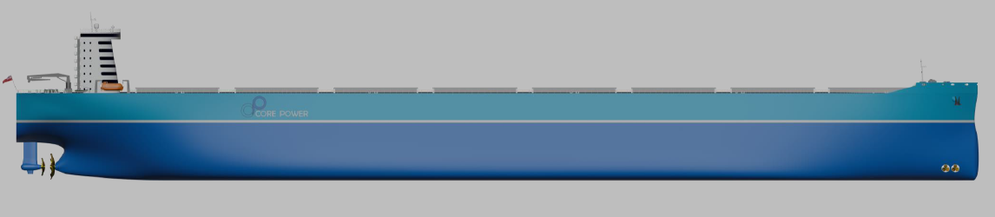
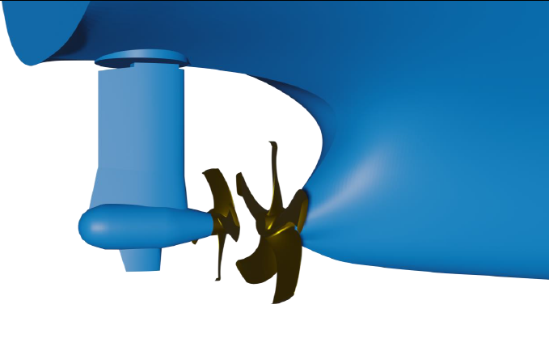
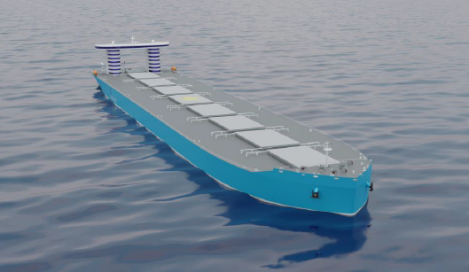
Hydrogen / Batteries / Nuclear

Slide 10
Thanks

