Slide 1
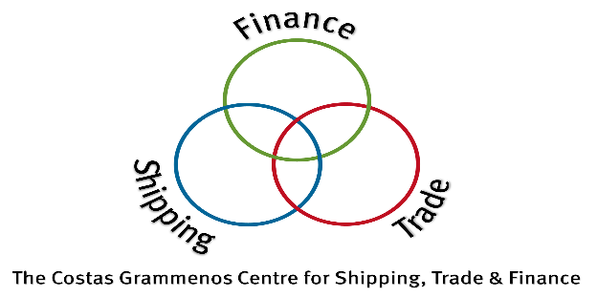
Environment, Regulations & Governance 10th City of London Biennial Meeting
Dr Ioannis C. Moutzouris

Slide 2
Initial IMO GHG Strategy: To Be Revised in 2023
In 2018, IMO adopted an initial strategy on the reduction of GHG emissions from international shipping, aiming at phasing them out as soon as possible
Includes candidate short-, mid- and long-term further measures with possible timelines and their impacts on States
Aims to reduce ${CO}_{2}$ emissions per transport work, as an average across international shipping, by at least 40% by 2030, pursuing efforts towards 70% by 2050, vis-à-vis the 2008 levels
By 2050, total annual GHG emissions from international shipping should be reduced by at least 50% compared to 2008
Environment, Regulations & Governance
2

Slide 3
Main Outcomes of MEPC 79
MEPC (Marine Environment Protection Committee) is the decision body
MEPC 79 took place from 12 to 16 December 2022
Main outcomes of MEPC 79 related to GHG emissions reduction:
Revision of initial IMO GHG Strategy
Development of mid-term measures including technical and economic measures
Adoption of the Revised Procedure of assessing possible impact on States of candidate measures
Development of Lifecycle GHG intensity of marine fuels guidelines
Proposals related to onboard CO2 capture
Revision of the IMO Fuel Consumption Monitoring Data Collection System (IMO DCS)
Environment, Regulations & Governance
3

Slide 4
MEPC 80: Increased Level of Ambition
MEPC 80 (3-7 July 2023) is expected to adopt the revised IMO Strategy for Reduction of GHG Emissions from Ships
Increased level of ambition compared to the initial strategy, beyond an at least 50% reduction in emissions by 2050
MEPC 79 confirmed its commitment to:
Continue its work on identifying the candidate GHG reduction measures to be developed in priority as part of a basket of measures consisting of both technical and economic elements by MEPC 80
Undertake a comprehensive impact assessment of the basket of candidate measures ahead of their adoption in accordance with the Work plan and the revised Procedure for assessing impacts on States
Environment, Regulations & Governance
4

Slide 5
Types of Technologies/Strategies Towards Decarbonisation
Technological measures
Naval engineering improvements:
Energy-saving devices; internal combustion engines; more efficient vessel designs (hull-form optimisation); propeller selection; air lubrication
Renewable energy forms: Wind propulsion and solar power
Low-carbon/cleaner fuels: LNG, Methanol
Zero-carbon/green fuels: Hydrogen, Ammonia, Biofuels, etc.
Optimisation of operations
Speed (reduction); weather routing; fleet and supply-chain management
Market-based-measures: Carbon Pricing; and Emissions Trading Schemes
Environment, Regulations & Governance
5

Slide 6
Relationship Between Freight Rates and Orderbook
54% Correlation
4% Correlation
Source: Clarksons Shipping Intelligence Network
Environment, Regulations & Governance
6

Slide 7
Shipping Investment Uncertainty
Traditionally, the primary investment risk had to do with freight rates volatility
When is the right time to order/buy/sell/scrap a vessel?
Should it be a newbuilding or a second-hand one?
The last years, there is also a technological risk
Uncertainty regarding the optimal fuel choice and the technological specifications of a newly ordered/purchased vessel
This depends on: the cost of fuel production; the availability and price of the fuel; the required technology for the vessel to burn that fuel; safety concerns; regulations (varying among jurisdictions); MBMs related to carbon prices; and the development of ETSs
Environment, Regulations & Governance
7

Slide 8
LNG-capable Fleet and Orderbook as % of Total (DWT)
Source: Clarksons Shipping Intelligence Network
Environment, Regulations & Governance
8

Slide 9
Fleet with Modern Eco Electronic Engine as % of Total
Source: Clarksons Shipping Intelligence Network
Environment, Regulations & Governance
9

Slide 10
Discrepancy Between Eco Price Premia and Eco Freight Premia
Source: Clarksons Shipping Intelligence Network
Shipping Decarbonisation
10

Slide 11
Modelled Energy Demand Mix to 2051
SZEF: Fuels that have the potential to achieve near-zero GHG emissions on a lifecycle basis while also scaling production in line with the pace of the transition (UMAS, 2021)
Source: UMAS (2021)
Environment, Regulations & Governance
11

Slide 12
Bayes Business School
(formerly Cass)
106 Bunhill Row
London EC1Y 8TZ
Tel + 44 (0)20 7040 8600
www.bayes.city.ac.uk

