Slide 1
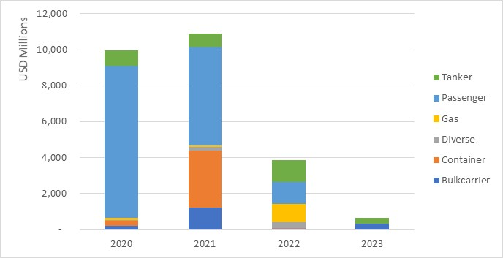
Capital market inflows to the shipping industry – Equities
Source: Clarksons
Shipping Finance II: Capital Markets
Bayes Business School Biennal meeting, London 12-13 June

Slide 2
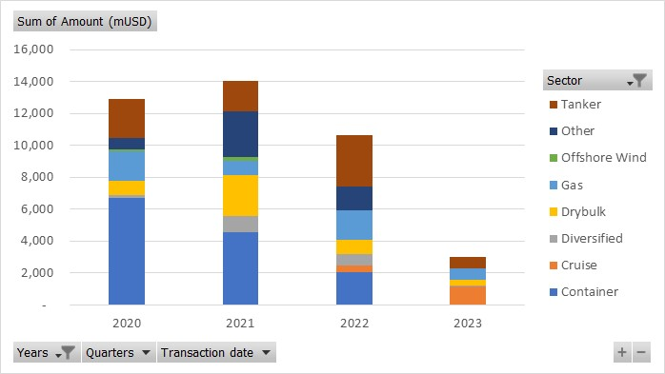
Capital market inflows to the shipping industry – bank loans
Source: Marine Money
Shipping Finance II: Capital Markets
Bayes Business School Biennal meeting, London 12-13 June

Slide 3
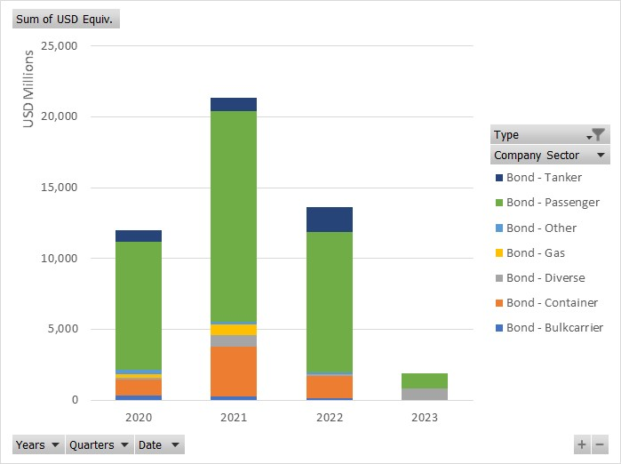
Capital market inflows to the shipping industry – bonds
Source: Clarksons
Shipping Finance II: Capital Markets
Bayes Business School Biennal meeting, London 12-13 June

