Slide 1
PhySical Limits of alternative fuels – How alternative fuels could change Shipping Forever

Slide 2
Dimensions of fuel adoption
COST
PHYSICS
SUPPLY
SAFETY

Slide 3
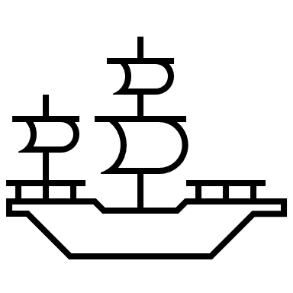
Energy Density - The Old World
80
70
60
50
HFO
MJ/L
40
30
20
10
10
20
30
40
50
60
70
80
90
100
110
120
130
140
150
MJ/kg
COAL

Slide 4
Energy Desity - Illustrating the NEW World
80
70
60
50
HFO
MJ/L
40
30
Methanol
LNG
20
Ammonia
H2
10
10
20
30
40
50
60
70
80
90
100
110
120
130
140
150
COAL
MJ/kg

Slide 5
Taking a closer look
Ammonia
Methanol
H2
LNG
Low in energy.
Higher tank capacity for same range.
Half the energy, means double price.
Toxic
Strong reaction in water
Low in energy.
Higher tank capacity for same range.
Double the volume means double price.
Poisionous, if ingested.
Burns without well visiable flame.
High in energy
High cost
Technically very challenging
Huge boil off / Volumes required
Explosive
Very little expertise available (long term)
High in energy
High cost
Double tank capacity for same range
Methane slip concerns
Boil off/Needs to be chilled

Slide 6
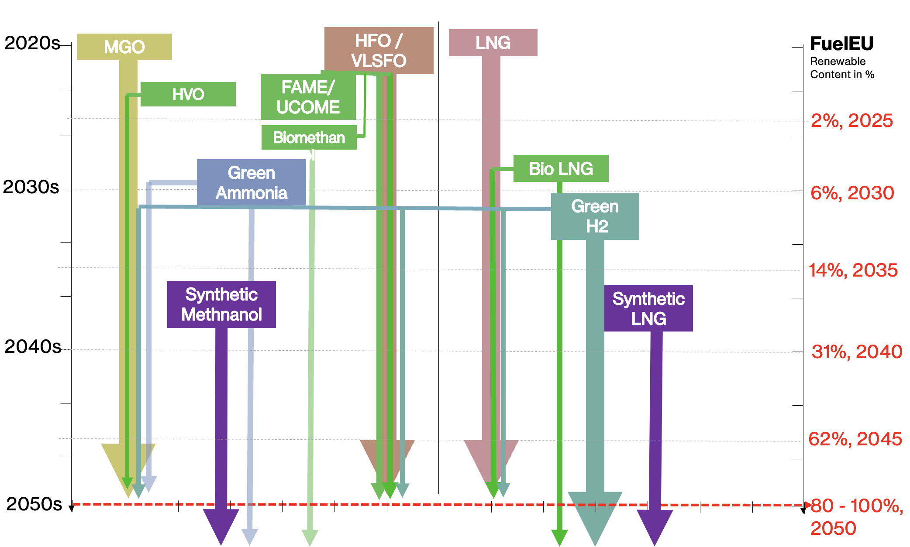
So where are thing likely heading? Drop - In - Fuels
Two paths only with 2 stroke engine.
Either Gas (LNG/Ethane/Propeane) Dual Fuel
Or Methanol Dual Fuel
Benefits: Route specific dosing
Cost of alternative fuels become more managable till ramp up
New ship designs will emerge for specific trading routes

Slide 7
Conclusion
Currently there is no silver bullet.
Alternative fuels are inferior to current status from pure technical/commercial standpoint without accounting for climate damages.
Drop in fuels are the future for the majority of the current fleet, till there is a better solution.
Due to the application of alternative fuels/biofuels transportation becomes less efficient.
The more alternative fuels are applied the more excessive will be the distortion of markets.
Local fuel availability and regulation will determine trade patterns.
Level playing field might be gone.

