Slide 1
Creating effective and innovative index-based longevity solutions
Longevity 14
James Maloney
21 September 2018

Slide 2
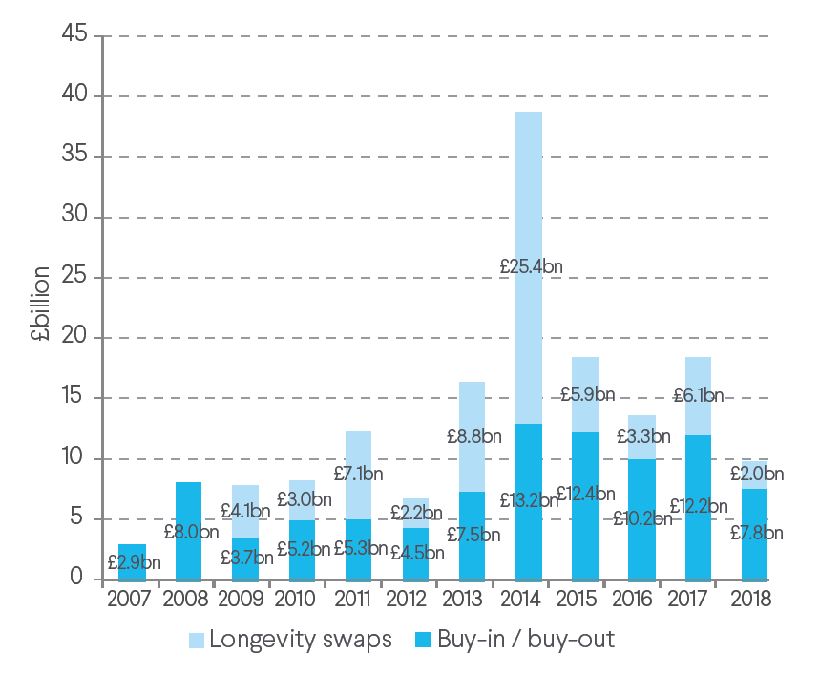
A growing demand for longevity de-risking UK market growth – DB pension scheme risk transfer
2007 – mid 2018
£93bn
Buy-in / buy-out
£67bn
Indemnity longevity Swaps
£0.1bn
Index longevity Swaps
Source: Buy-outs, buy-ins and longevity hedging – H1 2018, Hymans Robertson LLP
Index-based swaps: “untapped” market?

Slide 3
Why innovation is needed… The “elephants in the room”
Basis Risk
Portfolio experience differs from index: cannot achieve full indemnity
Finite Term
Hedging instrument is fixed-term: additional challenges at maturity
How to address the concerns?

Slide 4
Reducing the basis risk

Slide 5
Basis risk What is it?
Population Index
Portfolio
Basis Risk
Population indices equally weight each person in portfolio
But specific portfolios have:
Greater exposure to idiosyncratic risk
Different socio-economic mix to population
Unequal mix of liability exposure
Portfolio experience will differ from the index
How do we quantify basis risk?

Slide 6
Basis risk How much risk can be hedged?
Longevity Hedging 101
Coughlan et al
Towards an Industry Standard…
LBR Phase 1 report
Longevity Basis Risk Phase 2 report
2011
2014
2017
>80%
65-80%
50-80%
Industry level (v.large portfolio)
Liability hedge
10 year horizon
Portfolio level
Survival rates hedge
10 year horizon
Portfolio level
Variety of metrics
Run-off basis
Lower bound reflects inclusion of materially smaller portfolios.
How do we bring the bottom end of the range up?

Slide 7
Basis risk UK 2010-15: A case for indices based on demographic
Group | Annualised mortality improvement (age-standardised)
 | 2010-2015
England & Wales | 1.1% (±0.1%)
Club Vita | 1.3% (±0.4%)
Comfortable | 2.1% (±0.7%)
Making-do | 0.9% (±0.6%)
Hard-pressed | 1.0% (±0.6%)
~ 70% liabilities (typically)
Source: Club Vita & PLSA ‘Longevity Trends: Does One Size Fit All?’
How can we utilise this in hedging?

Slide 8
Basis risk Innovating to keep it low
Socio-economic Indices
Portfolio
Club Vita
Forthcoming
Portfolio
2018
75% - 90%*
Portfolio level
Variety of metrics
*Indicative results for a selection of large portfolios. Subject to detailed review and stress testing of modelling.
How have we assessed this?

Slide 9
Model framework part I: M7-M5

Slide 10
M7-M5 model Population-book approach
1
2
3
4
Reference Population
Reference Population
First, project mortality experience for reference population
Allow for age, period and cohort effects in projecting mortality rates
Portfolio
Portfolio
Subset of reference population
Need to project portfolio experience, balancing:
Coherence with population
Portfolio-specific effects
Project difference between population and portfolio

Slide 11
M7-M5 model Modelling the reference population (M7)
$$\operatorname{logit}{q_{xt}^{R}}=κ_{t}^{(1,R)}+\left(x−\overline{x}\right)κ_{t}^{\left(2,R\right)}+\left({\left(x−\overline{x}\right)}^{2}−σ_{x}^{2}\right)κ_{t}^{(3,R)}+γ_{t−x}^{R}$$
Transform to a scale in which broadly linear
Linear term (intercept and slope change over time)
‘Curl’ term (either top or bottom of ages, strength of ‘curl’ can change over time)
Cohort term (captures birth year specific impacts)
Mortality curve (year t)
$$κ_{t}^{(3,R)}$$
Time series
$κ_{t}^{(∗,R)}$: Multivariate Random Walk with Drift
$γ_{t−x}^{R}$: ARIMA
$$κ_{t}^{\left(1,R\right)}$$
Risks captured
Trend risk
$$κ_{t}^{(2,R)}$$
Age (x)

Slide 12
M7-M5 model Modelling difference between portfolio and reference popn. (M5)
$$\operatorname{logit}{q_{xt}^{B}}−\operatorname{logit}{q_{xt}^{R}} ={ κ}_{t}^{\left(1,B\right)} + \left(x−\overline{x}\right)κ_{t}^{\left(2,B\right)}$$
Difference in mortality between book and reference population (both on broadly linear scale)
Linear term (intercept and slope of the difference between book and reference population; can change over time)
No ‘curl’ or cohort term:
A portfolio-specific ‘curl’ cannot be supported
A portfolio-specific cohort is not required*
Time series
$$κ_{t}^{\left(1,R\right)}$$
$κ_{t}^{(∗,B)}$: Vector Autoregressive, order 1
$$κ_{t}^{\left(2,R\right)}$$
Risks captured
Trend risk
Time series
Idiosyncratic risk
Parameter uncertainty
Bootstrapping techniques
Age (x)
How to extend to socio-economic indices?

Slide 13
Model framework part II: M7-M5-M5

Slide 14
Extending to socio-economic indices Introducing the M7-M5-M5 model
Comfortable
Socio-economic groups (SEGs)
Subset of population
Project difference between population mortality and each SEG’s mortality
Making Do
Portfolio
Hard-Pressed
Portfolio
Combination of SEG subsets
Project difference between (weighted) average SEG mortality and portfolio mortality

Slide 15
Extending to socio-economic indices (1) Modelling the SEGs (M7-M5-M5)
Calibrate M7 model to national population
Model each SEG using M7-M5 framework
$$\operatorname{logit}{q_{xt}^{SEG(i)}}−\operatorname{logit}{q_{xt}^{R}} ={ κ}_{t}^{\left(1,SEG(i)\right)} + \left(x−\overline{x}\right)κ_{t}^{\left(2,SEG(i)\right)}$$
Age (x)

Slide 16
Extending to socio-economic indices (2) Calculating weighted average SEG
Calculate the weighted average mortality across SEGs
Weightings based on socio-economic mix of portfolio
$$q_{x,t}^{W.SEG}= \sum{w_{i}}∙q_{x,t}^{SEG(i)}$$
Age (x)

Slide 17
Extending to socio-economic indices (3) Modelling the portfolio (M7-M5-M5)
Model portfolio using M5-M5 approach:
$$\operatorname{logit}{q_{xt}^{P}}−\operatorname{logit}{q_{xt}^{W.SEG}} ={ κ}_{t}^{\left(1,P\right)} + \left(x−\overline{x}\right)κ_{t}^{\left(2,P\right)}$$
Age (x)

Slide 18
Preliminary results

Slide 19
Preliminary results
Illustrative, mixed portfolio
Trend risk only

Slide 20
Understanding the impact of finite term The next step in our research

Slide 21
Finite term contracts The ‘cure for cancer’ concern
Indemnity
Index
T
vs
Pre-defined approach

