Slide 1

Games as a pathway to digital skill adoption for reluctant older citizens
Mark Springett
Project ‘Gameplay for Inspiring digital adoption

Slide 2
Overview
Addressing the digital divide, specifically for older citizens using a gentle pathway
Games: separate learning of digital manipulations and the learning of digital utilities
Study one: Demonstrating learnability (mainly quantitative)
Study two: Investigate building blocks of supported learning (mainly qualitative)

Slide 3
The most reluctant learners
associated with age-related declines in motor, sensory, and cognitive skills (Rogers, Stronge, and Fisk, 2005)
negative attitudes stemming from fear, anxiety and lack of motivation (Heinz et al., 2013; Lee, Chien, and Hewitt, 2011)
tendency of older adults to underestimate their knowledge and abilities (Mitzner et al., 2010)
Lack of familiarity and exposure to technology in past employment/education occurred before the pervasive presence of technology

Slide 4
Key factors in adoption for older citizens
availability of help and support (Tsai, Shillair, and Cotten, 2017)
Usability: The growing popularity of a touch-based devices is changing perceptions of ICT usefulness and ease of usage (Smith, 2014)
attitudes and social influence Hur, (Kim and Kim 2014)
self-efficacy and expected outcomes (LaRose et al., 2012).

Slide 5
self-efficacy
three sources of self-efficacy beliefs (Bandura 1977) that relate to our approach
enactive mastery experiences
vicarious experiences (comparisons)
verbal persuasions (or similar social influences)

Slide 6
Enactive mastery experiences
supported through the use of games: intrinsic appeal, low pressure
Playful fascination can motivate users to repeatedly try actions until mastered through practice.
an electronic version of a familiar game it may be that positive self-efficacy with regard to that game may override negativity towards technology.

Slide 7
Vicarious experience in social games
performance similarity or differences, and structures success situations (achieving game completion)
Playing games allows users to witness and be witnessed.
peer comparison coupled with the instrumental goal of reinforcing learning of skills
close-coupled cooperative action, observation of action and witnessed action become interleaved.

Slide 8
Touch-based interaction
Touch-based interaction affords ‘natural’ interaction but naturalness is not an intrinsic property
Naturalness can be seen as an outcome of appropriate design
Naturalness should be evidenced by rapid learnability of core skills (Leung and Dickinger 2017)

Slide 9
Games for teaching digital interaction
Strong Mappings between analogue and digital world
Appealing/non-threatening for reluctant learners
Encourage exploration and repeated attempts at action

Slide 10
Touch Based Interaction for Older Citizens
Seen as affording Rapid learnability, acceptability, tolerance of motor issues and ease/comfort in the longer term
Tapping, dragging and rotating seen as core manipulation skills
Target size, space between targets, target location on the screen and fonts size seen as significant design features for older users (motti et al 2013).

Slide 11
Touch-based Social Interaction
Gesture Learning amenable to enhancement through social interactions
Learning seen as inherently social (Palinesar 1998) . True for older learners?
Mutual support may impact on fear/reluctance

Slide 12
Empirical Study 1
42 participants (20 male, 22 female) mean age 68.12 years (age range 64-82) based in Skopje, north Macedonia
Limited or no experience with digital technology (never used PC or operated a digital device)
Participants divided into dyads to play as a team. Mixed gender except for one
21 sessions lasting 25/30 minutes. Questionnaire on technology use and personal health followed by recorded play session
Smart Table 230i used for sessions

Slide 14
Game Choices
Two games with a progressive level of complexity
Use of concrete metaphors (world map, playing cards).
Introduction of the dragging gesture

Slide 15
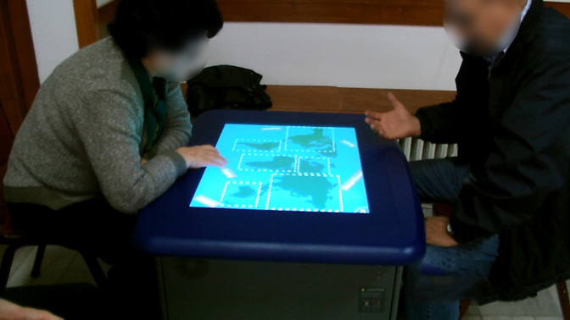
Hot Spaces
Outline of a world map
six city names on dragable labels
Successful placement recorded regardless of geographical accuracy

Slide 16
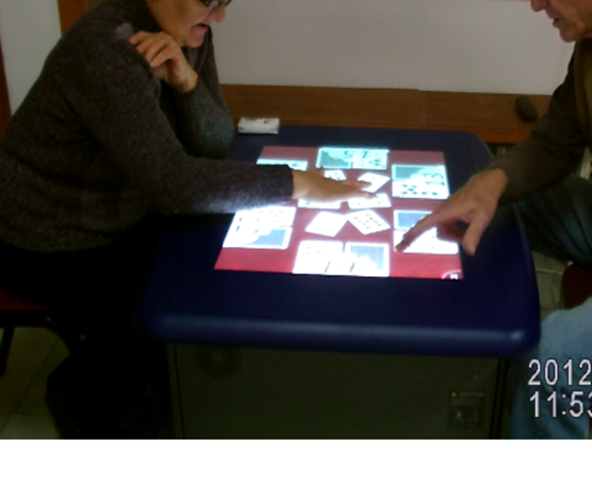
Hot Spots
Six static cards around table edges Six loose cards in the table centre
Each card pair had number-10 card, an overturned card with an unknown value and a large two-digit number displaying the sum of the card values.
Match 6 loose cards to the appropriate overturned slot using drag gesture
Evaluate how the learned drag gesture transfers from one game to another

Slide 17
Research goals and questions
Determine the learnability of DRAG in a collaborative environment
to what extent is learnability of the DRAG gesture retained/transferred?
Establish the positive effect of social interactions on the learning of the DRAG gesture
- Differences between dyads and single players in a previous study (Mihajlov et al 2015)

Slide 18
Results: Learnability of Drag
Participants spent most time solving the first game task discovering Drag: Performance must swifter in subsequent tasks Once learned the gesture was consistently performed correctly
In almost all cases the second player would mimic the first correct drag action
The number of correct gestures remained consistent Incorrect gestures decreased across tasks The correct action was discovered significantly quicker in gAME 2 (retained learning)
Participants in dyads reach this level significantly faster than single players from the previous study

Slide 19
positive effect of social interactions on the learning of the DRAG gesture
- dyads tended to discuss strategy in early stages and touch the screen less
- High incidence of verbal turns and explanatory (non-touching) gestures
number of correct gestures differed significantly between the dyads and the single players only for Task 1.
dyads completed in a significantly shorter time than singles for Tasks 2, 3 and 4.
- Suggests dyads an advantage in the key vulnerable stage of early learning

Slide 20
Establish the positive effect of social interactions on the learning of the DRAG gesture
number of correct gestures differed significantly between the dyads and the single players only for Task 1.
dyads completed in a significantly shorter time than singles for Tasks 2, 3 and 4.
- Suggests dyads an advantage in the key vulnerable stage of early learning
- More advanced player typically gave verbal or gesture explanation to the other player demonstrating manipulations
Non-active player often the first to notice an affordance (e.g. Noticing That a tapped label moved slightly)
some sessions dominated by one player. Mitigated by peer learning effects.

Slide 21

Inappropriate analogies from the analogue world only seen In early stages
-e.g. cutting along a jagged edge
Tapping and pointing to a
Location
Less prolonged than with
Single learners

Slide 22
Conclusions
Touch-based Games support rapid acquisition of core skills
Co-discovery through different formal of social interaction
Peer support significant given the exploratory nature of early learning
games appear to have the advantage of motivating and supporting exploration hypothesis generation and reactive planning in response to system feedback

Slide 23
Second Study – Mentored peer interaction
Explore the dynamics of interaction between peer learners
Study expert mentor behaviour
Identify appropriate ways of helping the most reluctant learners
Provide advice for professional and non-professional mentors

Slide 24
Second Study Conditions
Similar to first study except:
Experienced mentor briefed to intervene/support as appropriate
Twenty Eight participants (17 female and 11 male, Age range 66-86 (Ave 75.8))
32 inch Lenovo Multisurface touch screen
Different game suite, greater progressive complexity
Two condition: (Freehand draw) Solitaire, Jigsaw.

Slide 25
Analysis
Types of problem encountered by participants
Nature and influence of collaboration between players
Nature and influence of mentor

Slide 26
Findings
Numerous verbal declarations of low self-efficacy before sessions and occasionally early in sessions
Rarely repeated after early interaction
Mentors typically need to intervene/support in the earliest phases
Players getting used to the amount of pressure required
Advantage in starting with a conceptually simple game (drawing over Solitaire)

Slide 27
Collaboration Types
independent activity: No contact or co-ordination between players
Co-operative action: Players work out their roles in a collaborative task
Co-learning: Players discuss and work out principles whilst playing
Peer support: Verbal encouragement from one player to another
Copying of partners: Mimicry of observed actions
Mentor support: Where the mentor offers practical or affective support
Mentor intervention: Where the mentor takes over direct action with the device

Slide 28
Collaboration
Variations dependent on the game:
Independent action was most typical in freehand drawing and Solitaire
Some started independently, spent some time
working together on creating an image
Co-discovery of feature (key role for non-active player) recognition of affordance

Slide 29
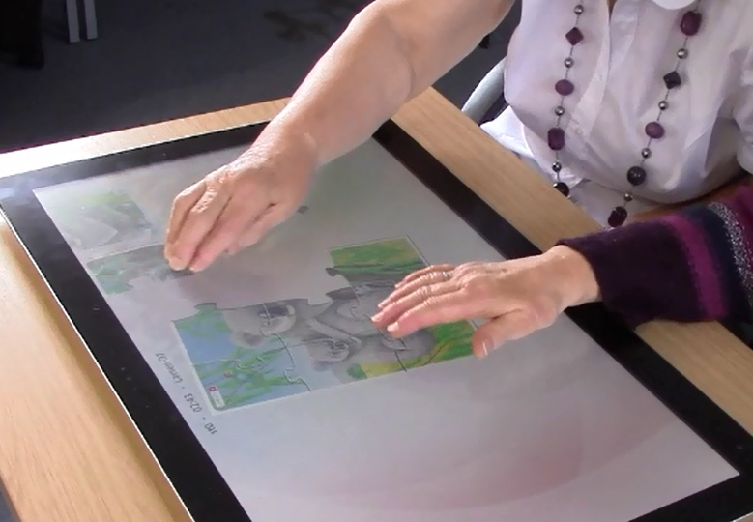
Collaboration
The Jigsaw game showed the highest degree of collaboration
Combination of verbal and non-verbal communication between participants
Short periods of independent activity
High degree of Co-ordinated activity

Slide 30
Nature of co-action
Principles of expert-novice collaboration observed in (Gill et al, Kendon) seem to apply to peer learner behaviour in highly collaborative tasks
negotiated turn-taking within a task).
non-verbal dialogue (air gestures pointing),
co-operative theory building
spontaneous collaborative action, (synchronous and parallel coordinated moves)
Suggests that co-learning supported best in games affording co-action

Slide 31
Analysis of mentoring (instrumental)
Air gestures and minimal instructions
Initial impetus
Encourage exploratory action (unfamiliar/unexpected concept)
Direct intervention relatively rare (typically after inadvertent action)
- preserve interaction flow
- Challenge management

Slide 32
Affective Support
Schema used by Fishbein, M., and Ajzen, I. (1975) models this type of support
E.g.
weakening the belief strength of an attitude that opposes the persuasive goal'. (`You're good at jigsaws you'll be good at this‘)
weaken the evaluation of an attitude that opposes the persuasive goal (`you're not getting it wrong, you're just learning‘)
`strengthen the evaluation of an attitude that supports the persuasive goal'. (e.g. complements on a created drawing)
Notes:
Belief, attitude,intention, and behavior. Reading, MA: Addison-
Wesley.

Slide 33
Current/Future work
Advice for mentors based on insights
Games as cognitive physical and social therapy
Potential use for early stage dementia patients

Slide 34
Outputs
An electronic copy of the GIRDA booklet ‘Your guide to using games to teach tablet skills’ can be found here https://www.onlinecentresnetwork.org/sites/default/files/a6_your_guide_to_using_games.pdf
An electronic copy of the Good Things Foundation’s guide to helping older people use the internet can be found here https://www.onlinecentresnetwork.org/sites/default/files/a6_your_guide_to_helping_older_people_use_the_internet.pdf

