Slide 1
Optimal Longevity Risk Transfer and Investment Strategies
Samuel H. Cox
Georgia State University
Yijia Lin
University of Nebraska - Lincoln
Sheen Liu
Washington State University
Presented at
Twelfth International Longevity Risk and Capital Markets Solutions Conference
Chicago, IL
September 29, 2016

Slide 2
Motivations
DB pensions introduce significant risks
Market downturns
Low interest rates
New pension accounting standards
Improved life expectancy of retirees
For example, DB plans of General Motors were underfunded by $8.7 billion in 2012
Pension de-risking through buy-ins and buy-outs
General Motors’ buy-out deal in 2012: $26 billion
Buy-ins and buy-outs in UK in 2015: ₤10+ billion

Slide 3
Motivations (Cont’)
Insurers operating in the buy-in and buy-out markets have been assuming a growing amount of longevity risk.
The implications of longevity risk on a bulk annuity insurer’s overall risk still have not been explored.
Little is known about the extent to which longevity risk should be ceded to maximize value of a bulk annuity insurer.

Slide 4
Contributions
We study how much longevity risk an insurer should transfer given that longevity risk and other business risks are managed holistically.
We apply the duality and martingale approach to the reinsurance purchase decision and derive an optimal longevity risk transfer strategy.
We consider both longevity risk and investment risk of an insurer.
We formulate the problem subject to general risk constraints (e.g. VaR).
We obtain explicit solutions.

Slide 5
Contributions (Cont’)
We illustrate how to optimally o­ffload longevity risk with longevity bonds to maximize firm value.

Slide 6
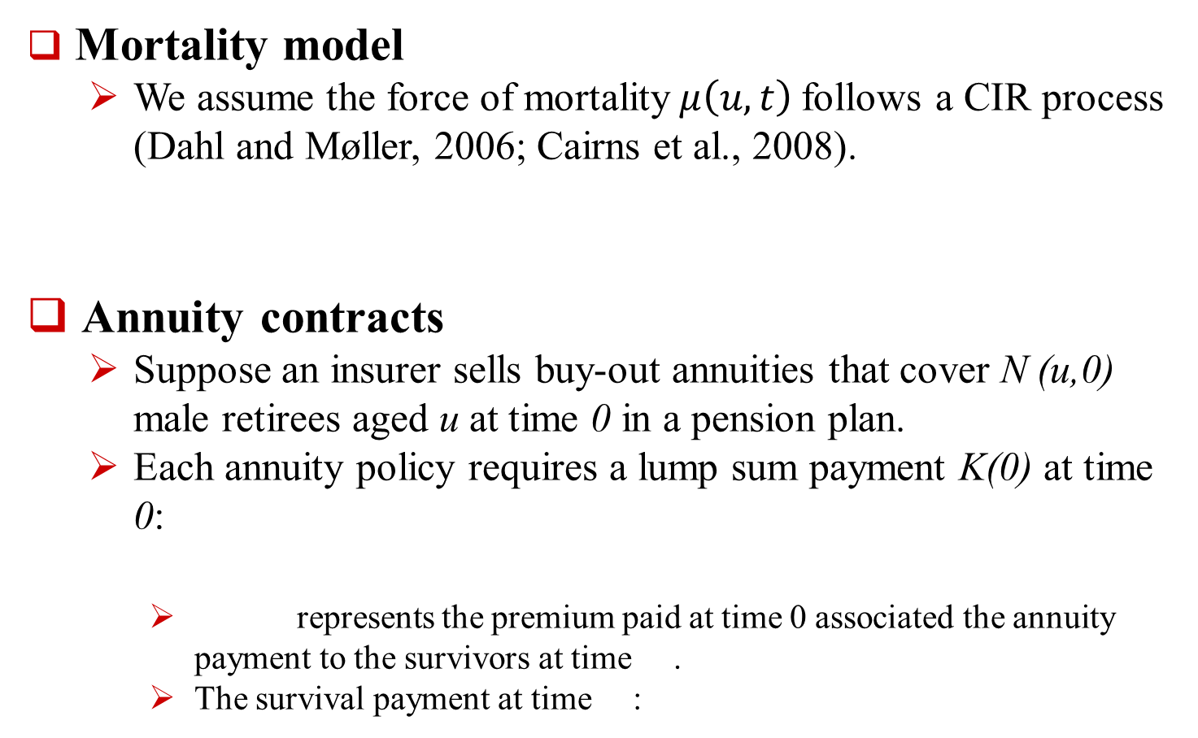
Basic Framework
Mortality model
We assume the force of mortality$μ\left(u,t\right)$follows a CIR process (Dahl and Møller, 2006; Cairns et al., 2008).
Annuity contracts
Suppose an insurer sells buy-out annuities that cover N (u,0) male retirees aged u at time 0 in a pension plan.
Each annuity policy requires a lump sum payment K(0) at time 0:
represents the premium paid at time 0 associated the annuity payment to the survivors at time .
The survival payment at time :

Slide 7
Basic Framework (Cont’)
Insurance assets
Stock index investment I(t): Geometric Brownian motion
Money market investment C(t)
Insurance surplus

Slide 8
Reinsurance Decision
Assume the insurer transfers a proportion ξ of its annuity business to a reinsurer at time 0.
The insurer sells the stock index and the investment in the money market to pay the reinsurance premium.
The change in surplus after purchasing reinsurance equals

Slide 9
Basic Optimization Problem with Reinsurance
Our dynamic optimization model is to solve for the optimal reinsurance ratio and stock investment, so as to maximize the expected value of the insurer’s utility at time T:
where V(T) is the insurer’s surplus at time T .

Slide 10
Basic Optimization Problem with Reinsurance (Cont’)
The optimal number of shares of the stock index n1 and the optimal reinsurance ratio :
We apply the convex dual approach to solve our dynamic utility optimization problem.

Slide 11
Optimization with Logarithmic Utility
We assume the insurer has a logarithmic utility function (Pulley, 1983):
The duality method provides explicit solutions for the logarithmic utility function.
Investors maximizing their expected logarithmic utility would hold the same portfolios as investors maximizing certain mean-variance functions (Pulley, 1983).
We solve the dynamic optimization problem with the stock investment constraint and the overall risk constraint based on VaR.

Slide 12
Optimization Results

Slide 13
Optimization Results (Cont’)

Slide 14
Numerical Illustration
The insurer has a surplus of V(0)=$30 million at time 0.
The insurer issues an annuity contract for age 65 at time 0 that will make one survival payment at .
The lump-sum premium K(0) of this annuity contract at time 0 is $300 million.
Longevity risk premium is 3.14%.
The insurer cannot invest more than 20% of its assets in equity and it cannot short sell the stock index.
The risk premium of the stock index is 6% with a volatility equal to 20%.
The probability that the insurer will lose more than half of the initial surplus ($15 million) should not be greater than 0.1% in the next six months.

Slide 15
Gompertz-Makeham Law of Mortality
is the force of mortality of age u+t.
The estimates from Dahl and Møller (2006)

Slide 16
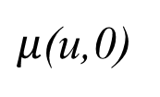
CIR Mortality Process with the Gompertz-Makeham Law
The estimates from Dahl and Møller (2006)
Assume = 0.017 for age u=65 at t=0.
$μ$(u,0)

Slide 17
Equity and Longevity Risk Contributions

Slide 18
Optimal Reinsurance and Investment Decisions in the First Six Months
The insurer should invest 1.5 × $30M = $45M in the stock index and $285M in the money market.
The insurer should retain 7.2447 × $30M = $217.3M annuity business.
The insurer sells $300M annuity contracts. It should transfer $82.7M of its annuity business to a reinsurer.

Slide 19
Optimization with Longevity Bond
One unit of a longevity bond that will pay a survival benefit equal to at time Ti, Ti = t+1, t+2,…,TL, is sold at a price of at time t.
The insurer purchases units of this longevity bond.
The optimal retained annuity business equals
The optimal stock investment and longevity bond are

Slide 20
Conclusion
We study how to optimally transfer longevity risk exposures in buyout annuities for an insurer.
The optimal reinsurance decision depends on other risks (e.g. investment risk) of an insurer.
We apply the convex duality approach with a logarithmic utility function to solve for the optimal reinsurance strategy.
We show how a capital market solution with a longevity bond can achieve an optimal longevity risk transfer.

