Slide 1
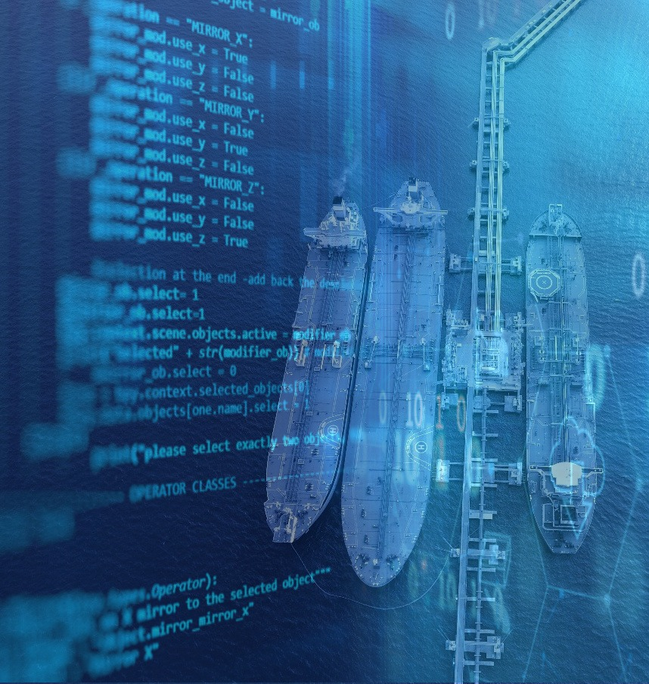
Digitalisation in the Tanker Industry
Mette Frederiksen
Head of Research & Insight at Tankers International

Slide 2
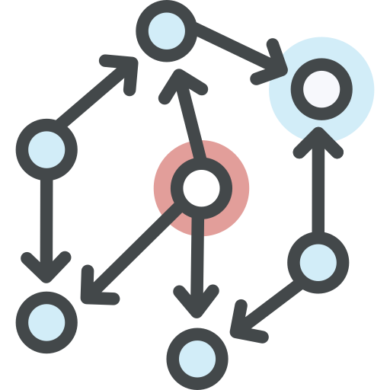
Digitalisation The balance between automation and human skill
Vessel Equipment
Automation vs. Practical Knowledge
Automatic Data Flow
Data organisation and validation
Manual Reporting
Data standardisation to ensure quality
Combining Data Sets
Data integration & predictive modelling
HIGHLY SKILLED PEOPLE

