Slide 1
10th City of London Biennial Meeting
12th and 13th June 2023

Slide 2
Backdrop – Security of Supply

Slide 3
Since Russian pipeline supplies collapsed, Europe depends on high send-out from its LNG import terminals
Data source: Rystad Energy

Slide 4
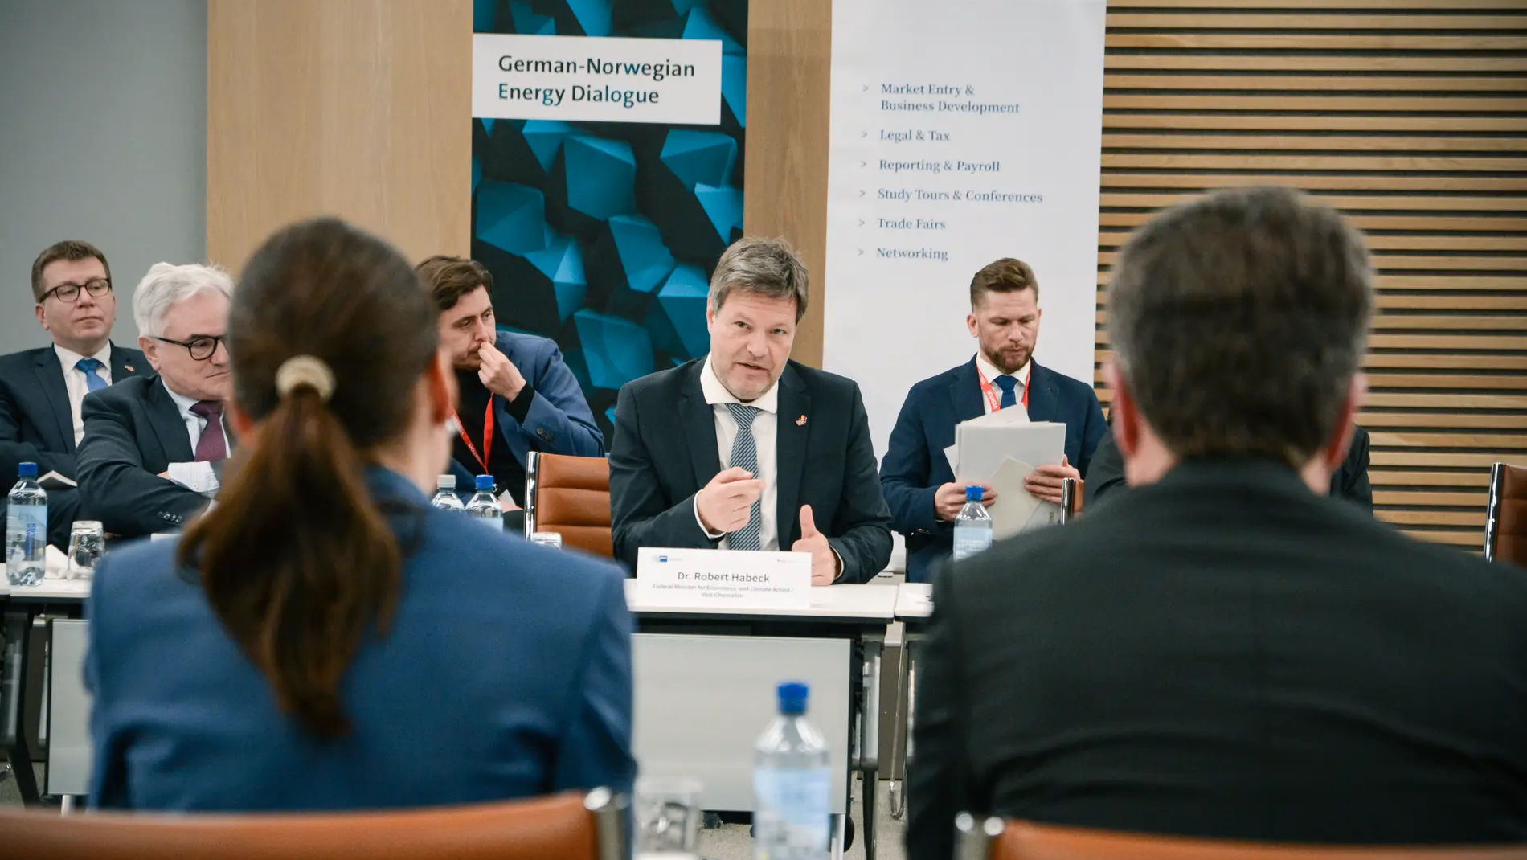
Foto: Felix Reimann E24

Slide 5
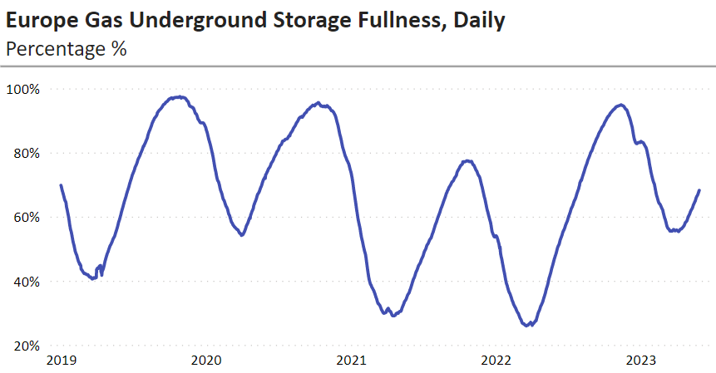
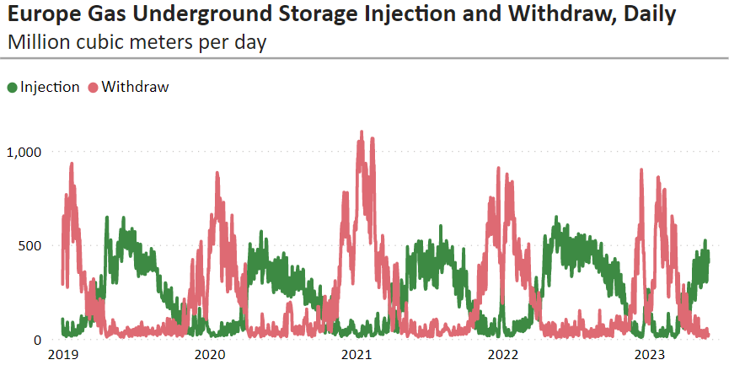
Storage inventory at high levels following mild winter: 68.2% in Europe ex Ukraine, 74.4% in Germany
Source: Rystad Energy
Notes:
Data from May 29.

