Slide 1
Bayesian Inference for Small Population Longevity Risk Modelling
Liang Chen, CERA
Supervised by: Prof Andrew Cairns, Dr Torsten Kleinow
Actuarial Research Centre, IFoA
Heriot Watt University
September 29, 2016

Slide 2
Stochastic Model
We select stochastic model “M7” to reflect the work of Cairns et al. (2009), which suggests it fit the males from England and Wales well.
Recall the formula for M7:
$$D\left(t,x\right)|θ_{1}∼Poi(m\left(θ_{1},t,x\right)E(t,x))$$
$$\text{logit} q\left(θ_{1},t,x\right)=κ_{t}^{(1)}+κ_{t}^{\left(2\right)}\left(x−\overline{x}\right)+κ_{t}^{\left(3\right)}\left({\left(x−\overline{x}\right)}^{2}−{\hat{σ}}_{x}^{2}\right)+γ_{c}^{\left(4\right)}$$
$θ_{1}=(κ_{t}^{\left(1\right)},κ_{t}^{\left(2\right)},κ_{t}^{\left(3\right)},γ_{c}^{\left(4\right)})$
$κ_{t}^{\left(i\right)}$ is a period effect in year $t=t_{1},…,t_{n_{y}}$ for each $i=1, 2, 3.$
$γ_{c}^{\left(4\right)}$ is the cohort effect for the cohort born in year $c=t−x$ for $t=t_{1},…,t_{n_{y}}$ and $x=x_{1},…,x_{n_{a}}$.
$\overline{x}$ is the mean of the age range we use for our analysis.
${\hat{σ}}_{x}^{2}$ is the mean of ${\left(x−\overline{x}\right)}^{2}$.

Slide 3
Two-Stage Approach
Stage
Find the estimates for period and cohort effects, ${\hat{θ}}_{1}$ by maximising the Poisson likelihood.
Fit time series model to these effects.
Most pension schemes are less than 1% of national population.
Two-stage approach leads to biased estimates of volatility for small populations.
Large sampling variation affects latent parameter estimation, with significant noise obscuring the true signal (Cairns, Blake, Dowd et al. 2011).
Results in non-negligible bias to the parameter estimation of the projecting model, given the assumed true rates (Chen, Cairns and Kleinow 2015).
Over fit the cohorts with only one observation (a problem with the two-stage approach: see Cairns et al. 2009)

Slide 4
Bayesian Approach
Bayesian approach offers a way to avoid or reduce this bias by
Combining Poisson and time series likelihoods
Using knowledge of larger England and Wales dataset to choose more informative priors than one might normally choose.
We use England and Wales death rates as a benchmark to test how well the Bayesian approach with informative priors performs.

Slide 5
Data
Benchmark exposure $E_{0}\left(t,x\right)$ and corresponding deaths count $D_{0}\left(t,x\right)$ of the males in England and Wales (EW) in the HMD database, during year 1961 to 2011, aged 50-89 last birthday.
Simulate $D_{w}(t,x)$, where $w=0.01$ based on
$$D_{w}\left(t,x\right)|{\hat{θ}}_{0}∼\text{Poi}(m\left({\hat{θ}}_{0},t,x\right)wE_{0}(t,x))$$
where
${\hat{θ}}_{0}$: parameter estimates for benchmark $D_{0}\left(t,x\right),$ i.e. EW
$m\left({\hat{θ}}_{0},t,x\right)$ is the fitted death rates given ${\hat{θ}}_{0}$, that is ${\hat{θ}}_{0}$ is the true rates for $D_{w}\left(t,x\right).$
Find the parameter estimates ${\hat{θ}}_{w}$ for $D_{w}\left(t,x\right).$

Slide 6
Notations
$θ_{1},$the vector of all the latent parameters
$θ_{11}={\left(κ_{t_{1}}^{\left(1\right)},κ_{t_{1}}^{\left(2\right)},κ_{t_{1}}^{\left(3\right)}\right)}^{T}$, vector of period effects at year $t_{1}$
$θ_{12}$, vector of the rest of period effects
$θ_{13}=γ_{t_{1}−x_{n_{a}}}^{\left(4\right)}$
$θ_{14}$, vector of cohort effect for the rest cohorts

Slide 7
Prior for $κ$ and $γ^{\left(4\right)}$
$θ_{11}∝$ uniform distribution
$θ_{12}$, multivariate random walk:
$$κ_{t}=κ_{t−1}+μ+ε_{t}$$
where
$μ={\left(μ_{1}, μ_{2}, μ_{3}\right)}^{T}$ is the drift (hyper-parameter).
$ε_{t}∼MVN(0,V_{ε})$, i.i.d three dimensional multivariate normal distribution independent of $t$.
$θ_{14}$, AR(1) model:
$γ_{c}^{\left(4\right)}=α_{γ}γ_{c−1}^{\left(4\right)}+ε_{c}$, for $c>t_{1}−x_{n_{a}}$,
where $ε_{c}$ are i.i.d and $ε_{c}∼N(0,σ_{γ}^{2})$.
$γ_{c}^{\left(4\right)}|γ_{c−1}^{\left(4\right)}∼N(α_{γ}γ_{c−1}^{\left(4\right)},σ_{γ}^{2})$
$γ_{t_{1}}^{\left(4\right)}∼N(0,\frac{σ_{γ}^{2}}{1−α_{γ}^{2}})$

Slide 8
Prior for Hyper-Parameters
$V_{ε}∝$ Inverse Wishart $(ν,Σ)$
MCMC-Mean: Fix the mean of prior to ${\hat{V}}_{ε}^{EW}$
MCMC-Mode: Fix the mode of prior to ${\hat{V}}_{ε}^{EW}$(sensitivity test)
$μ∝$ uniform
$α_{γ}∝{\left(1−α_{γ}^{2}\right)}^{g}$ for $\left|α\right|<1$
$σ_{γ}^{2}∼\text{Inverse} \text{Gamma} (a_{γ},b_{γ})$

Slide 9
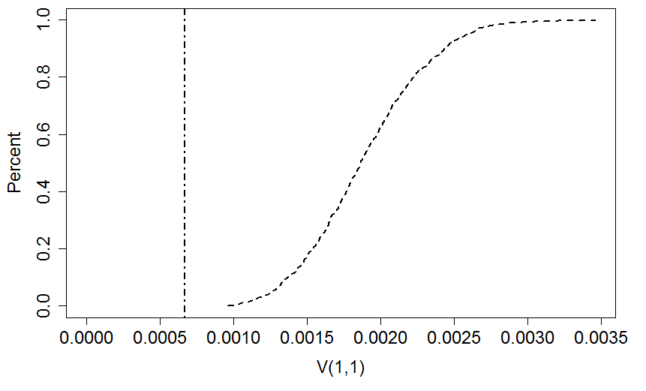
$V_{ε}$ given MLE
${\hat{θ}}_{0}$
${\hat{θ}}_{w}$ for w=0.01

Slide 10
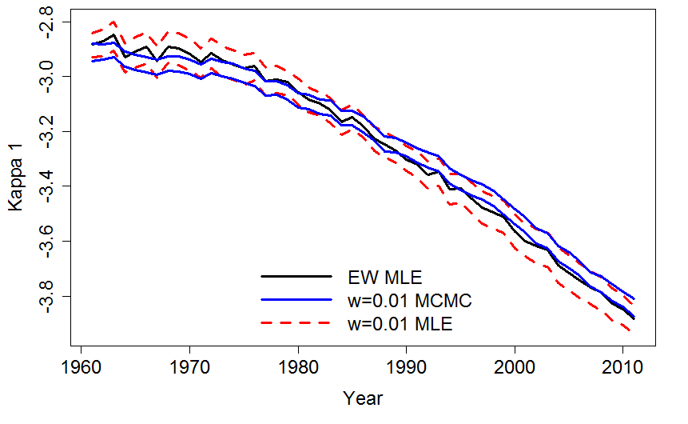
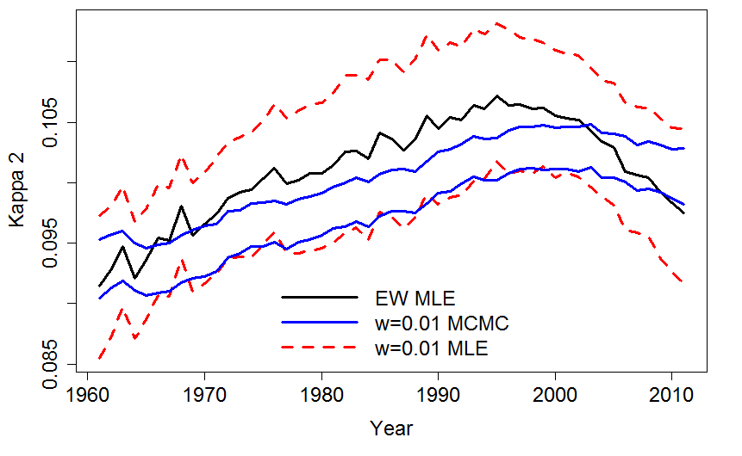
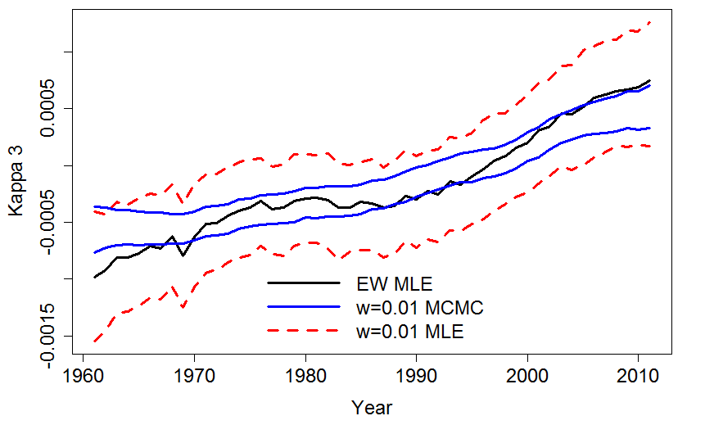
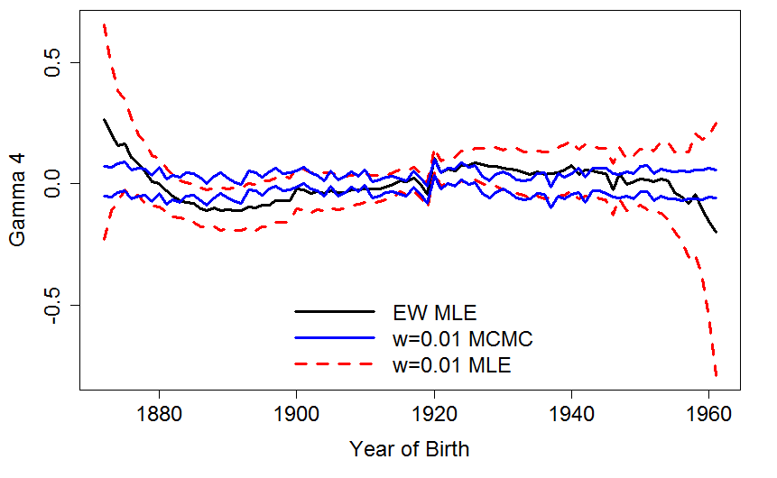
Credibility Interval for $κ$ and $γ^{\left(4\right)}$

Slide 11
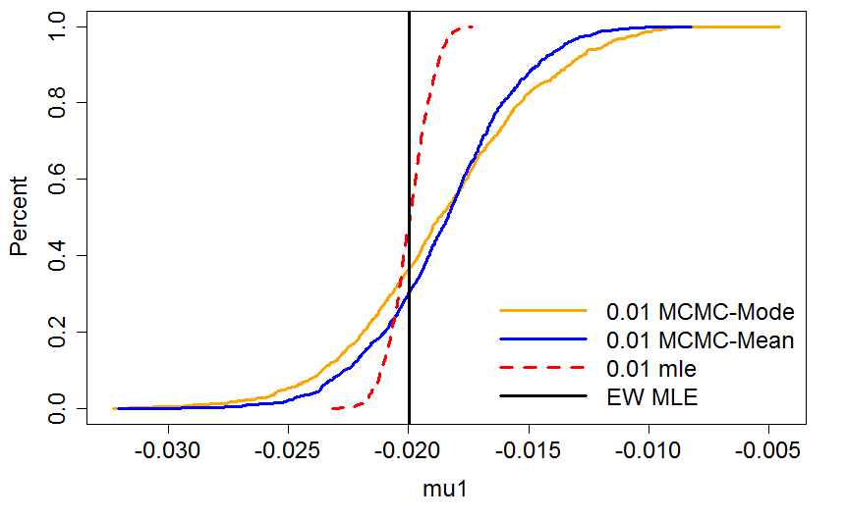
CDF for $μ_{1}$ with Sensitivity Test

Slide 12
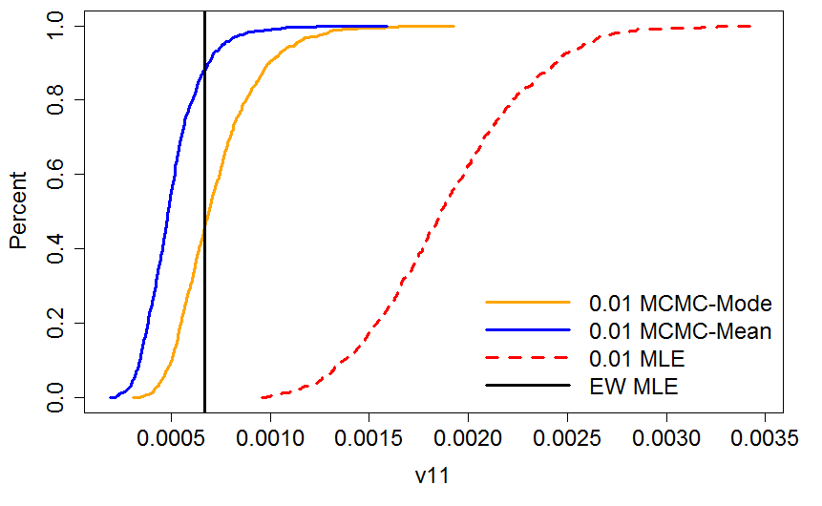
CDF for $V_{ε}(1,1)$ with Sensitivity Test

Slide 13
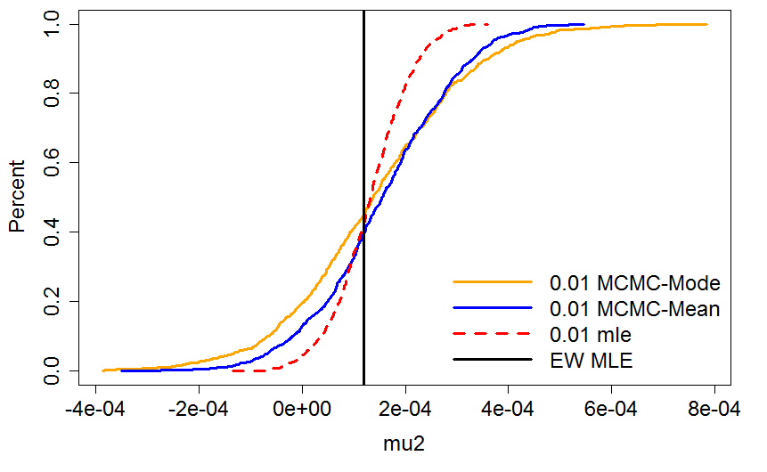
CDF for $μ_{2}$ with Sensitivity Test

Slide 14
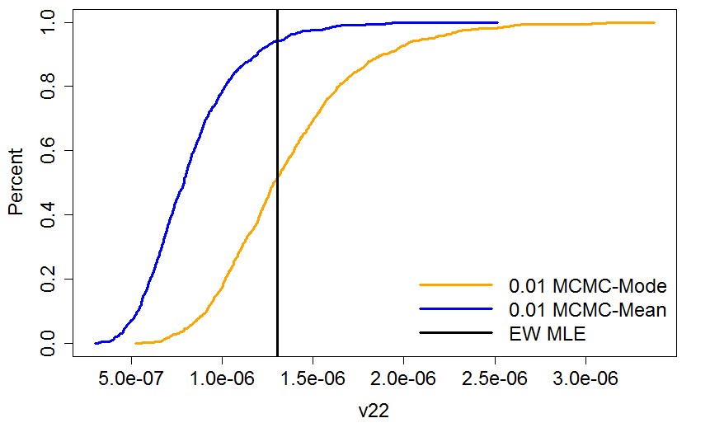
CDF for $V_{ε}(2,2)$ with Sensitivity Test

Slide 15
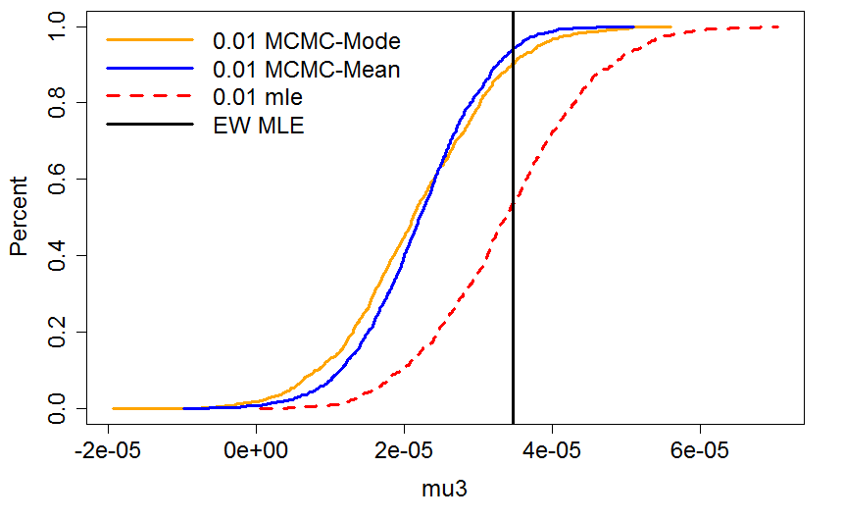
CDF for $μ_{3}$ with Sensitivity Test

Slide 16
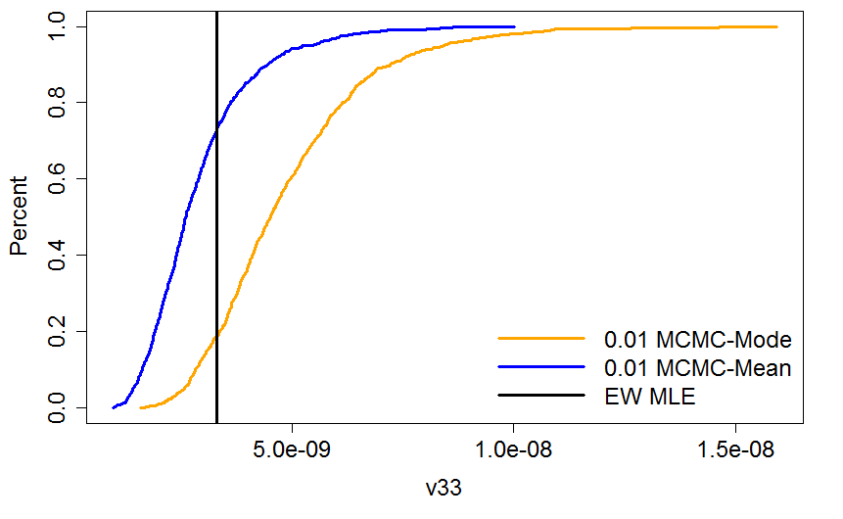
CDF for $V_{ε}(3,3)$ with Sensitivity Test

Slide 17
Conclusion
For small population
The co-variance matrix estimated by MLE is significantly biased to the right of the assumed true value due to the Poisson model’s over fitting.
We combined the two stages into one by adding time series likelihood for the latent parameters and gained the posterior distribution with the MCMC procedure.
The Bayesian method provides an improved fit to the hyper parameter $V_{ε}$.
The low level information involved in short cohorts is balanced by the time series prior.
The posterior distribution for small population is sensitive and fixing the mode of the prior for the co-variance matrix to the assumed true rates provides approximately unbiased fit to $V_{ε}$

Slide 18
Questions
Comments

